Slide 1

Network Properties&
Random Graph Model
Lei Zou
Peking University
zoulei@pku.edu.cn

Slide 2
Outline
Key Network Properties
Measure Real-world Networks.
Graph Generation Model
Random Graph Model
Small-World Model
Barabasi-Albert (BA) Model
Kronecker Graph Model

Slide 3
Part 1
Key Network Properties

Slide 4
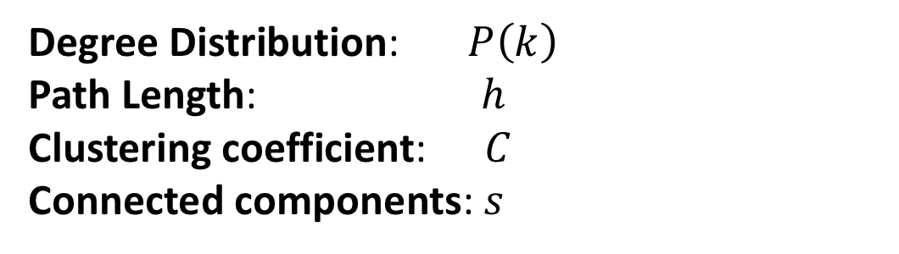
Network Properties
How to measure a network ?
Key Network Properties
Degree Distribution:$P\left(k\right)$
Path Length:$h$
Clustering coefficient:$C$
Connected components:$s$

Slide 5
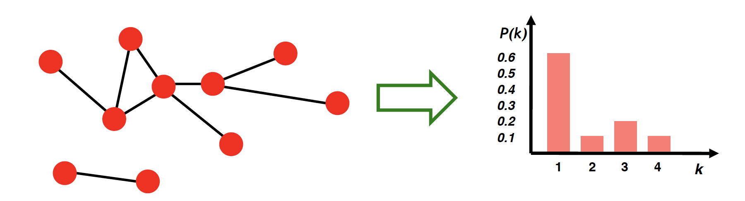
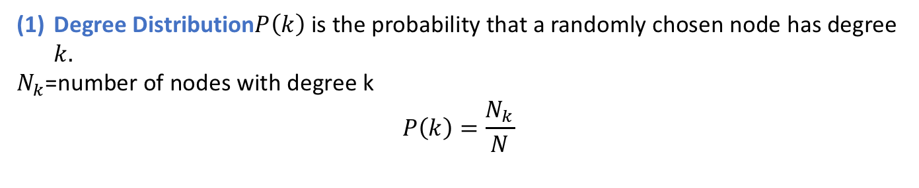
Network Properties
Degree Distribution$P\left(k\right)$ is the probability that a randomly chosen node has degree $k.$
$N_{k}$=number of nodes with degree k
$$P\left(k\right)=\frac{N_{k}}{N}$$
For directed graphs we have separate in- and out-degree distributions

Slide 6
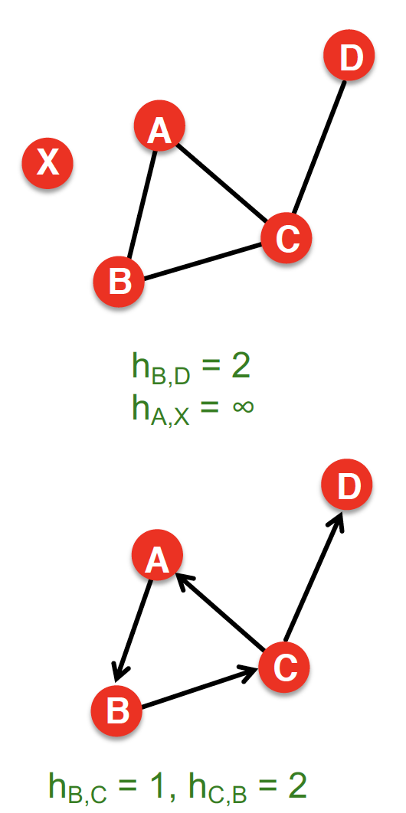
Network Properties
(2) A path is a sequence of nodes in which each node is linked to the next one.
Shortest Path Distance between a pair of nodes is defined as the number of edges along the shortest path connecting the nodes.
In directed graphs, paths need to follow the direction of the arrows.

Slide 7
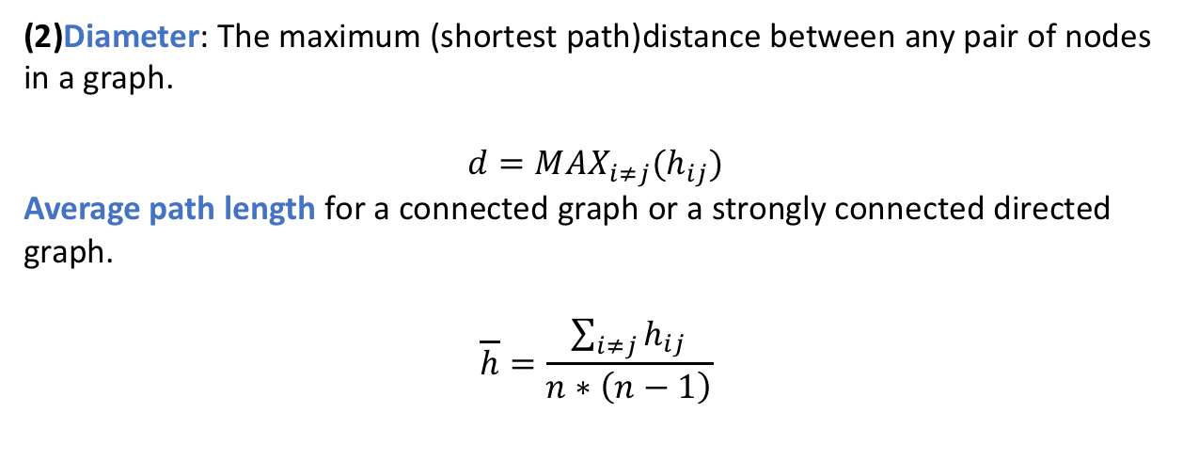
Network Properties
(2)Diameter: The maximum (shortest path)distance between any pair of nodes in a graph.
$$d=MAX_{i≠j}(h_{ij})$$
Average path length for a connected graph or a strongly connected directed graph.
$$\overline{h}=\frac{\sum_{i≠j}{h_{ij}}}{n∗\left(n−1\right)}$$
Many times we compute the average only over the connected pairs of nodes (that is, we ignore “infinite” length paths).

Slide 8
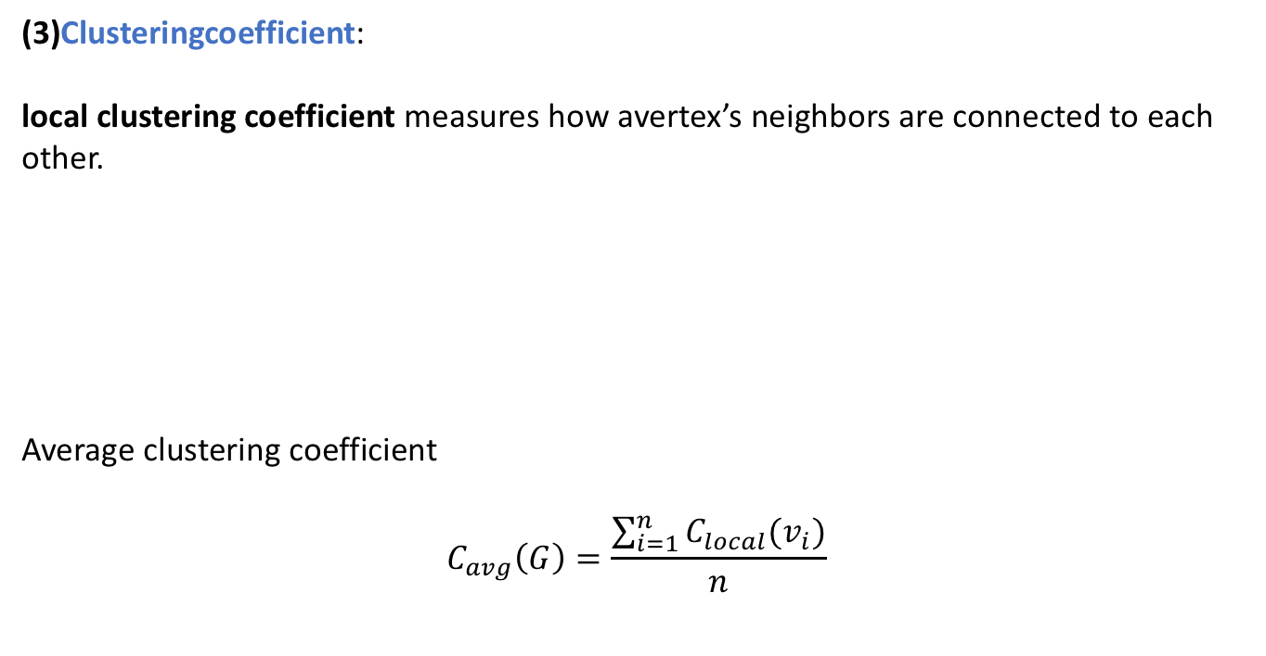
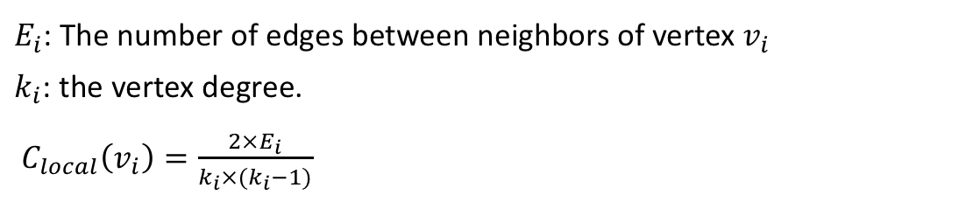
Network Properties
(3)Clusteringcoefficient:
local clustering coefficient measures how avertex’s neighbors are connected to each other.
Average clustering coefficient
$$C_{avg}\left(G\right)=\frac{\sum_{i=1}^{n}{C_{local}(v_{i})}}{n}$$
$E_{i}$: The number of edges between neighbors of vertex $v_{i}$
$k_{i}$: the vertex degree.
$C_{local}\left(v_{i}\right)=\frac{{2×E}_{i}}{k_{i}×{(k}_{i}−1)}$

Slide 9
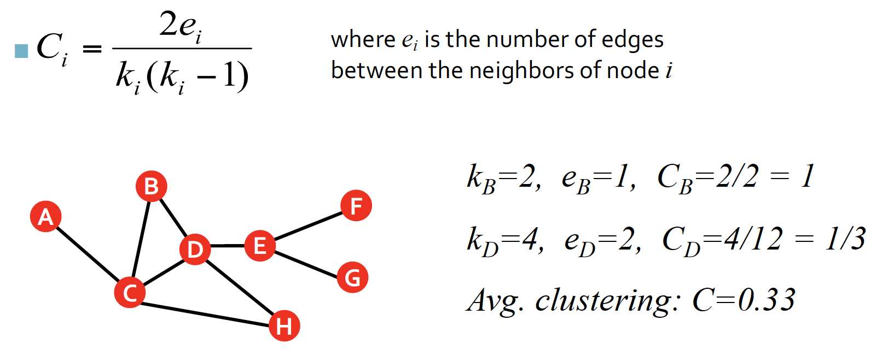
Network Properties
(3) Clustering coefficient:

Slide 10
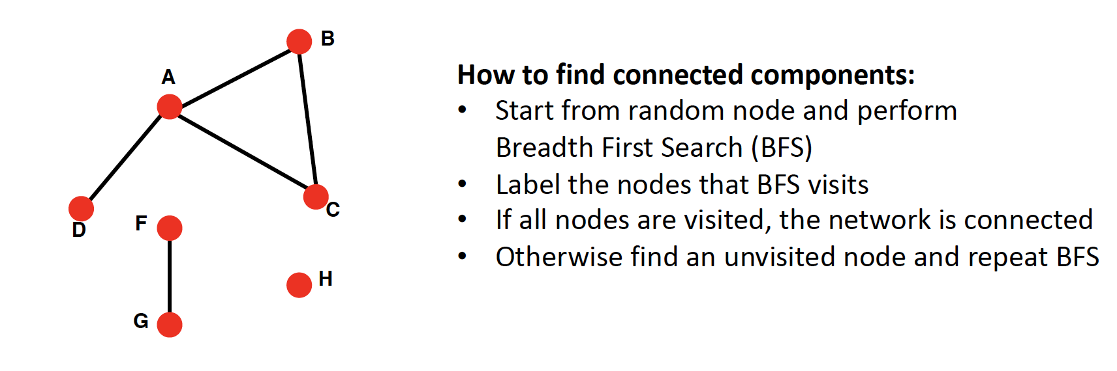
Network Properties
(4) Connectivity :
Size of the largest connected component
Largest set where any two vertices can be joined by a path.
Largest component = Giant component

Slide 11
Part 2
Measure Real-world Networks

Slide 12

e.g. MSN networks

Slide 13
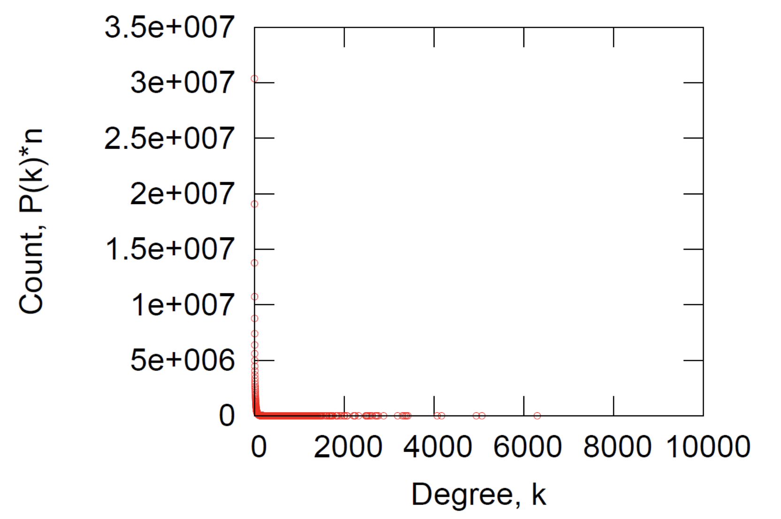
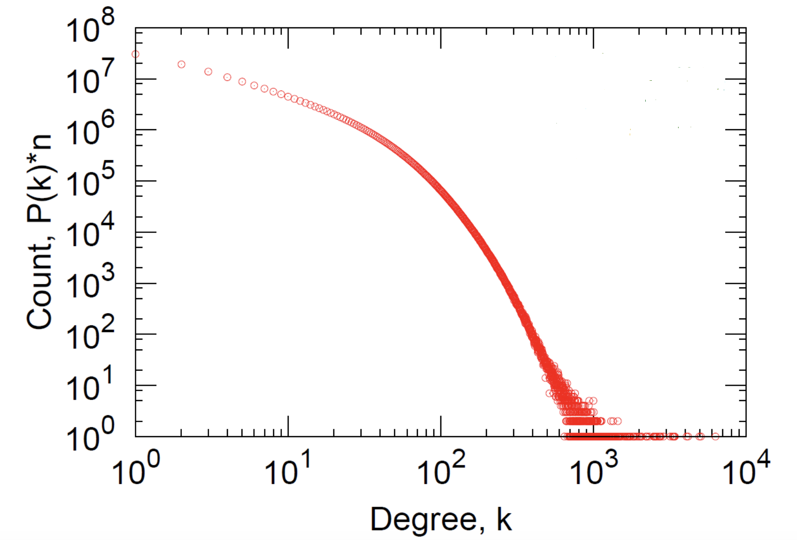
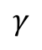
Degree Distribution
where is a parameter whose value is typically between 2 and 3.
$$γ$$

Slide 14
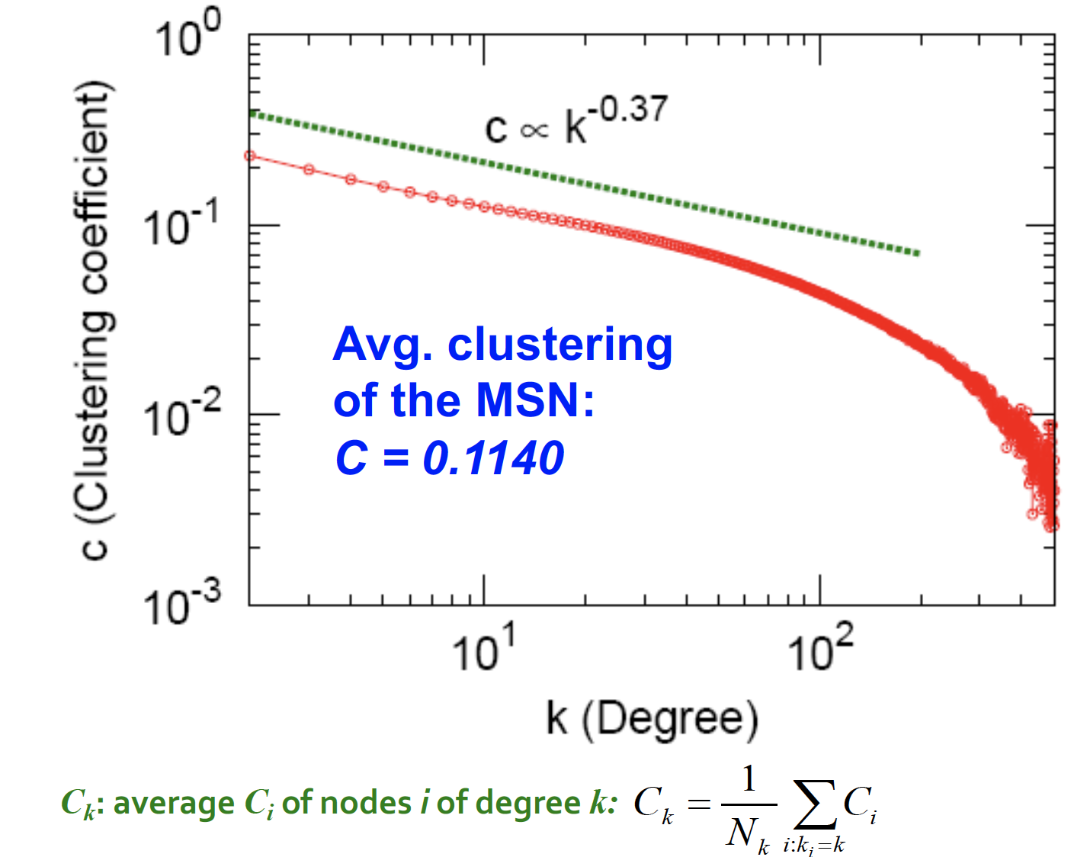
Clustering Coefficient

Slide 15
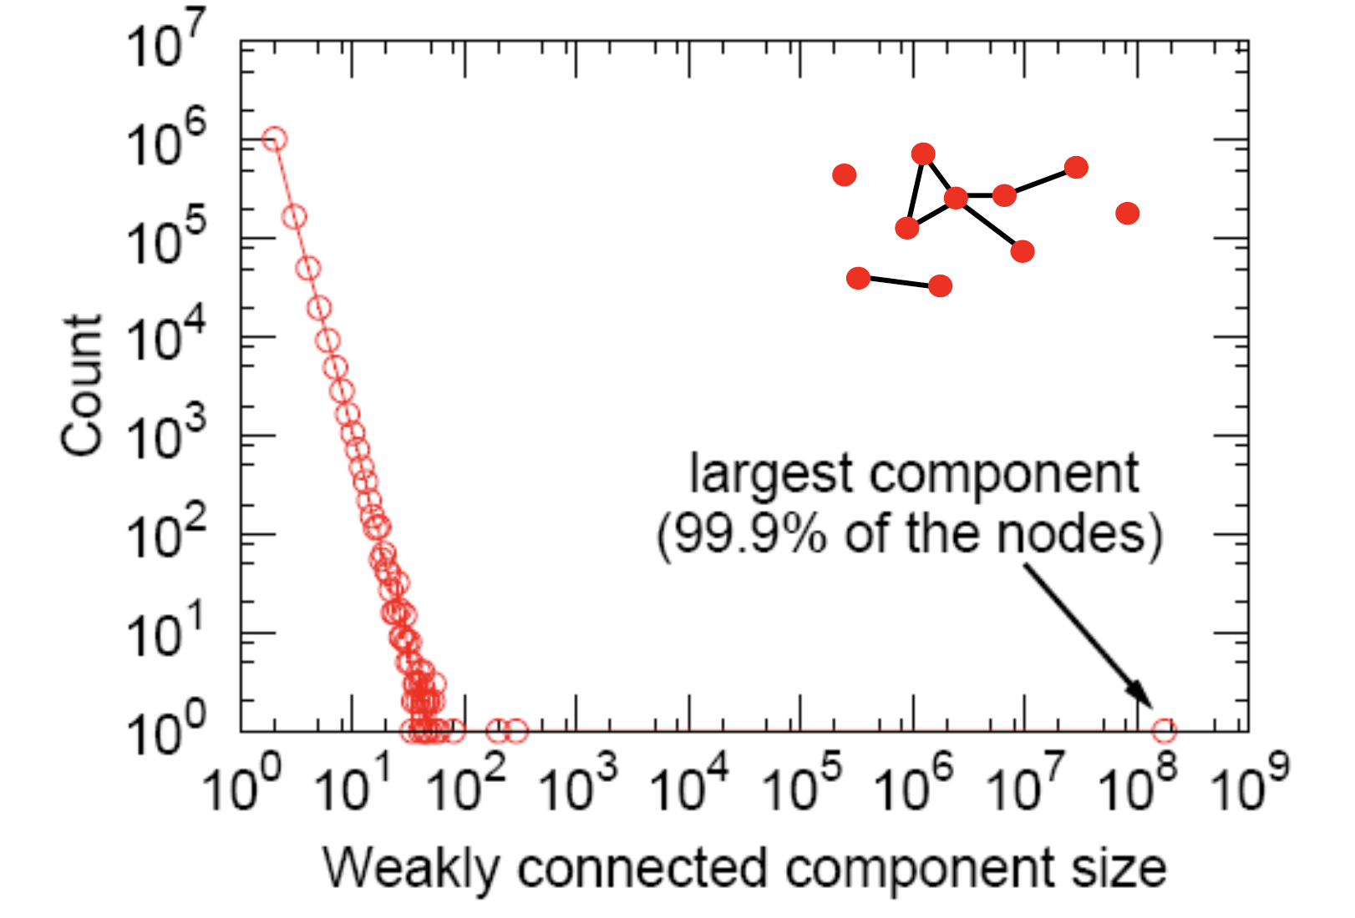
Connected Components

Slide 16
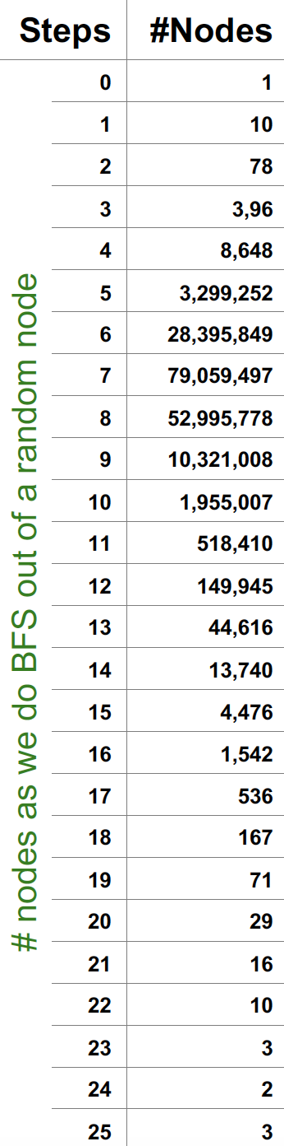
Diameter of WCC
“Six degrees of
separation”
Avg. path length 6.6
90% of the nodes can be reached in < 8 hops

Slide 17
Real-world Networks: Key Network Properties (e.g. MSN)
Degree distribution: Heavily skewed,
average degree=14.4
Path Length: 6.6
Clustering Coefficient: 0.11
Connectivity: giant component

Slide 18
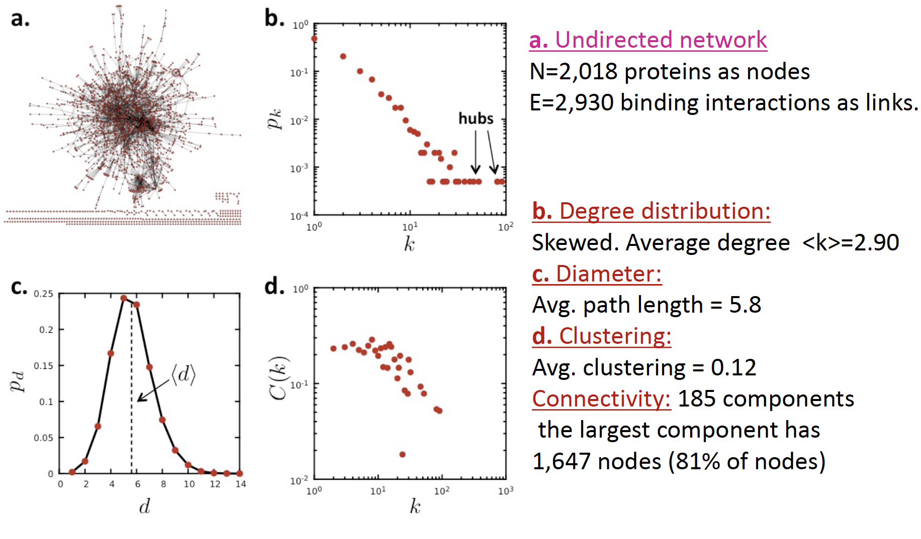
Another example: PPI network

Slide 19
Six Degree
Small World Effect
Six Degrees of Separation-----Jeffrey Travers (Harvard U) & Stanley Milgram (The City U. of New York), 1967.
“Arbitrarily selected individuals (N=296) in Nebraska and Boston are asked to generate acquaintance chains to a target person in Massachusetts. 64 chains reach the target person. Within this group the mean number of the intermediaries between the starters and targets is 5.2. The funneling of chains through sociometric is noted, with 48% of the chains passing through three persons before reaching the target.”

Slide 20
Small World Graphs
A small-world network is a type of mathematical graph in which most nodes are not neighbors of one another, but most nodes can be reached from every other by a small number of hops or steps.
L: The distance between two randomly chosen nodes.
N: The number of nodes in a network.

Slide 21
Part 3
Graph Generation Model

Slide 22
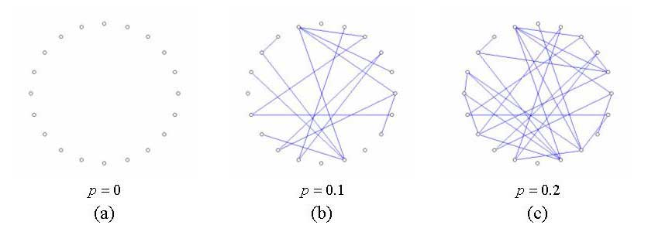
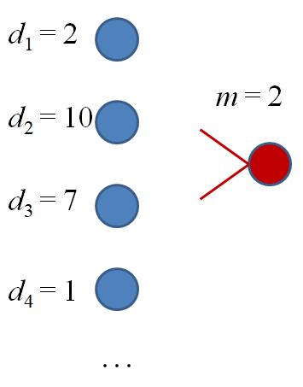
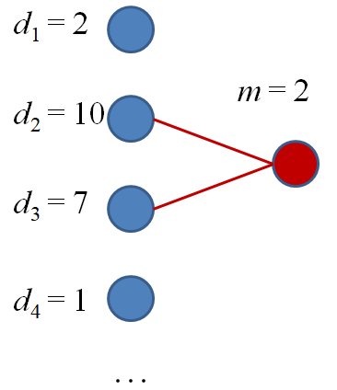
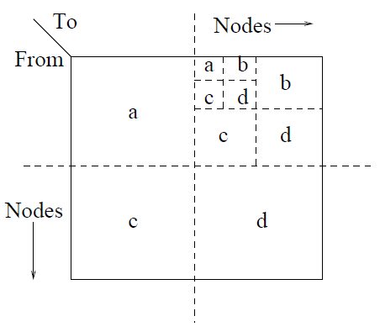
Typical Graph Generation Models
Stochastic block model
Contains r disjoint blocks C₁,…C_{r}
Each node u has probability p_{i} of belonging to C_{i}
Edge probabilities specified by matrix P_{r×r}
ER graph, e.g., G(n, p) model
Community structure
short length
Barabasi-Albert (BA) model
Recursive graph model (R-MAT,
Kronecker)
Power law, scale-free
Communities-within-communities

Slide 23
Random Graph Model

Slide 24
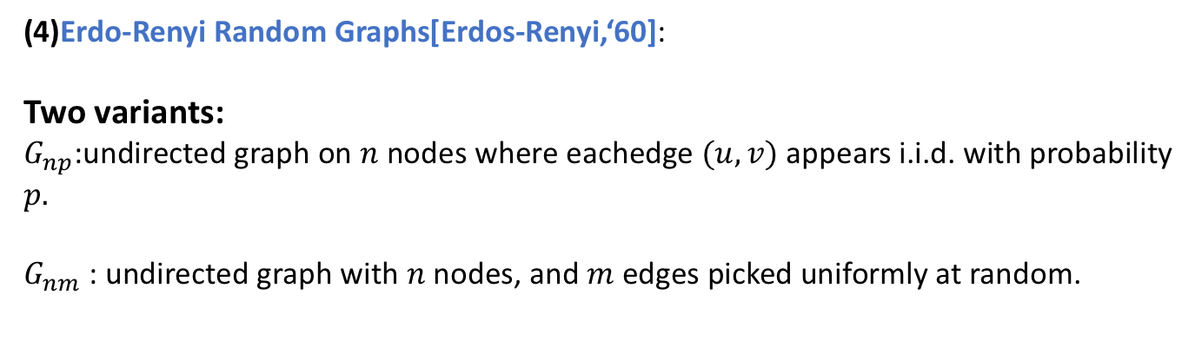
Simplest Model of Graphs
(4)Erdo-Renyi Random Graphs[Erdos-Renyi,‘60]:
Two variants:
$G_{np}$:undirected graph on $n$ nodes where eachedge $(u,v)$appears i.i.d. with probability $p.$
$G_{nm}$ : undirected graph with $n$ nodes, and$m$ edges picked uniformly at random.
What kind of networks do
such models produce?

Slide 25
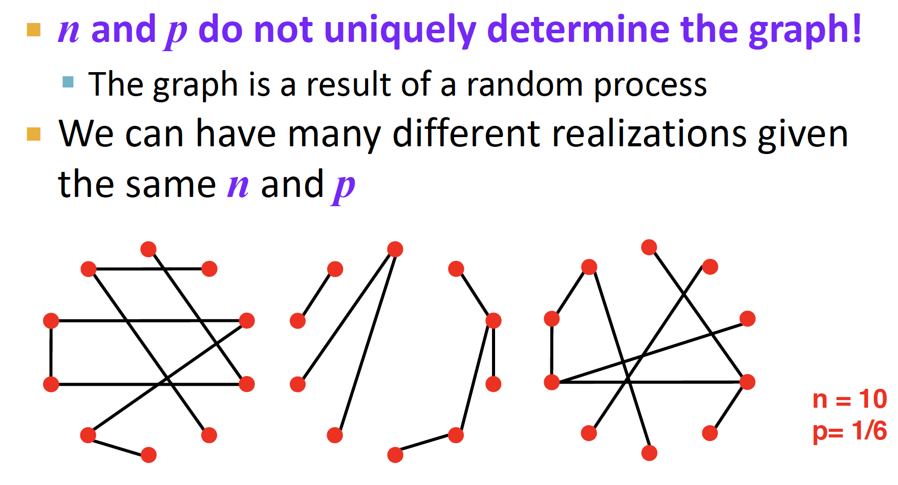
Simplest Model of Graphs
(4) Erdo-Renyi Random Graphs [Erdos-Renyi, ‘60] :

Slide 26
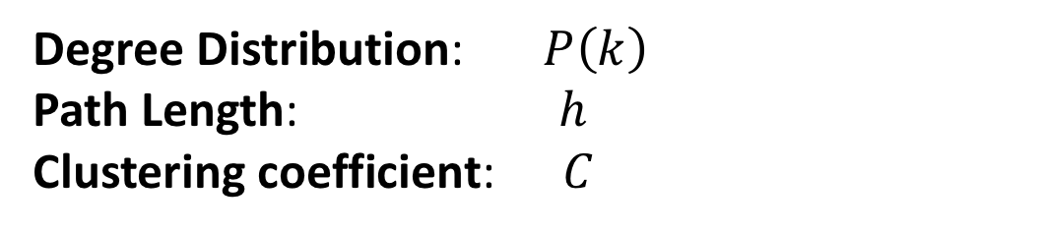

Properties of E-R Random Graph
Degree Distribution:$P\left(k\right)$
Path Length:$h$
Clustering coefficient:$C$
What are the values of these properties for $G_{np}$?

Slide 27
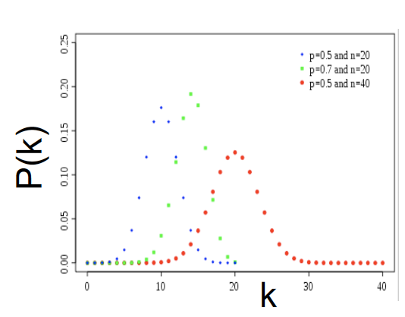
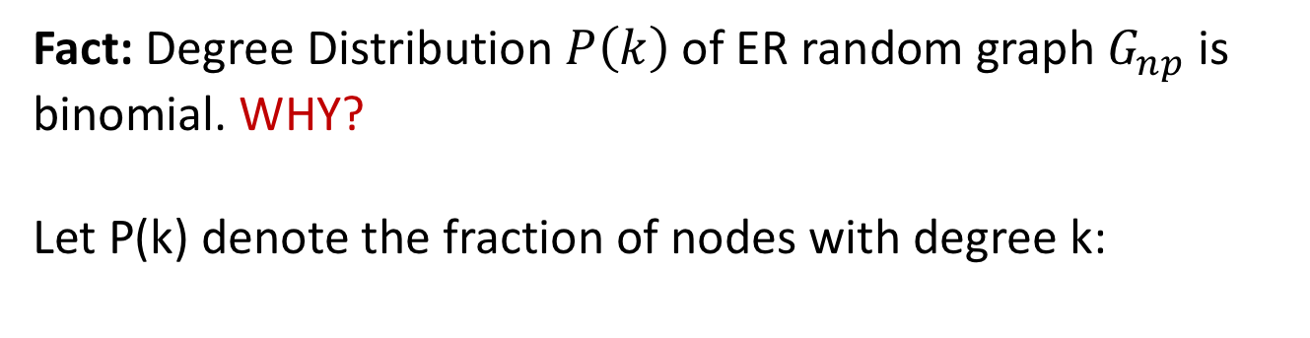
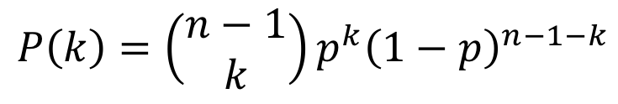
Degree Distribution
Fact: Degree Distribution $P\left(k\right)$ of ER random graph $G_{np}$ is binomial. WHY?
Let P(k) denote the fraction of nodes with degree k:
$$P\left(k\right)=\left(\begin{aligned}n−1 \\ k\end{aligned}\right)p^{k}{\left(1−p\right)}^{n−1−k}$$
Select k nodes
out of n-1
Probability of
missing the rest of
the n-1-k edges
Probability of
having k neighbors.

Slide 28
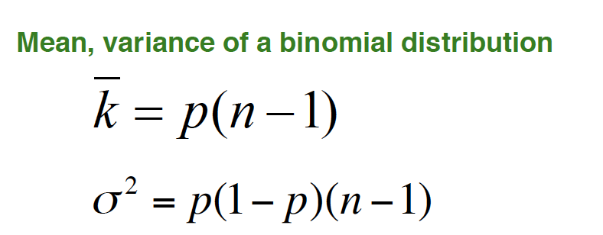
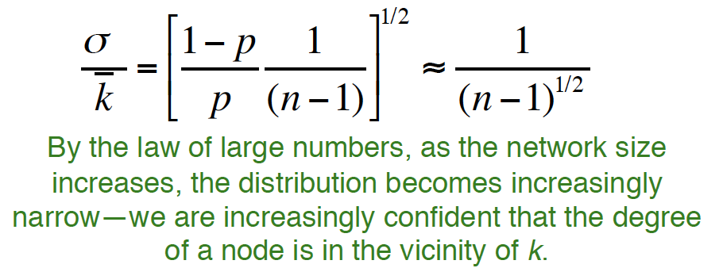
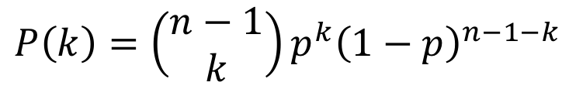
Degree Distribution
$$P\left(k\right)=\left(\begin{aligned}n−1 \\ k\end{aligned}\right)p^{k}{\left(1−p\right)}^{n−1−k}$$

Slide 29
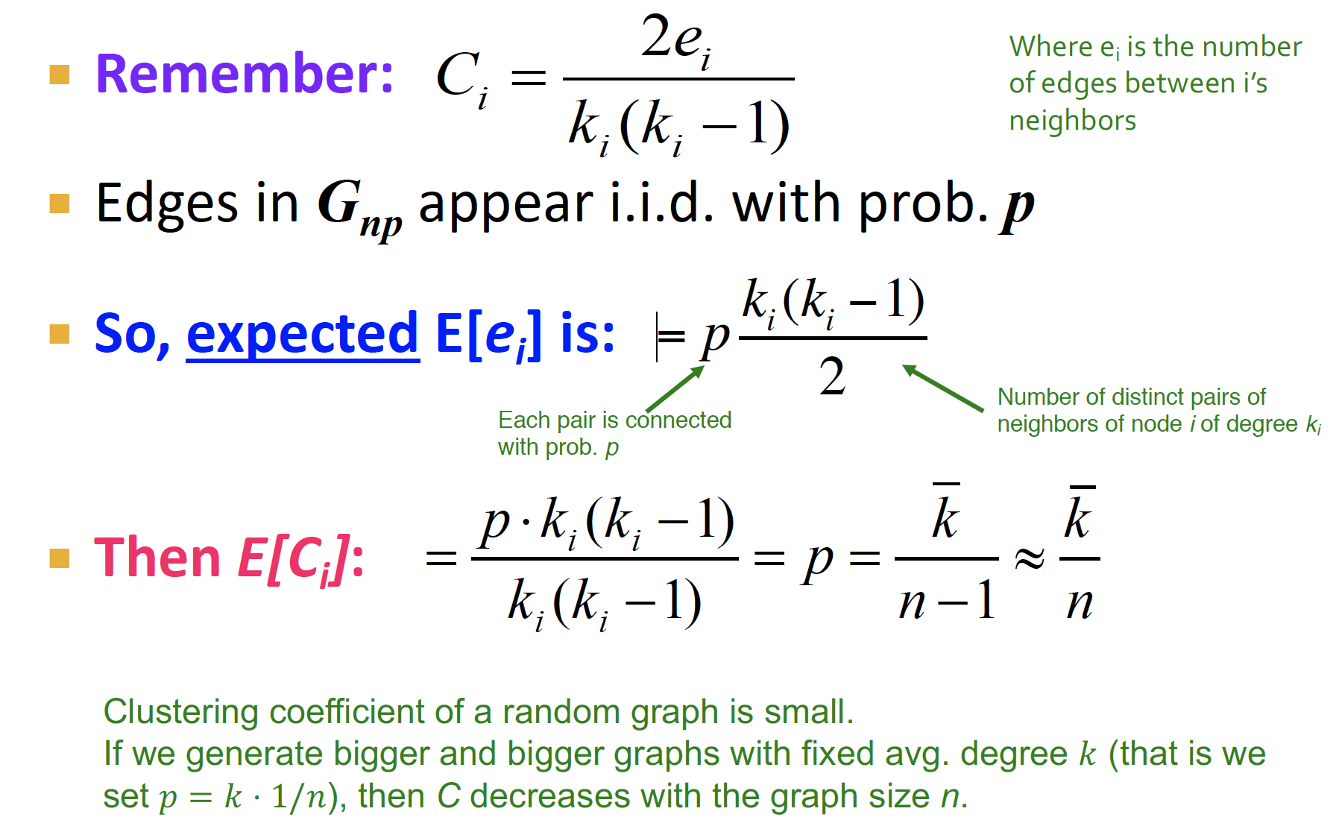
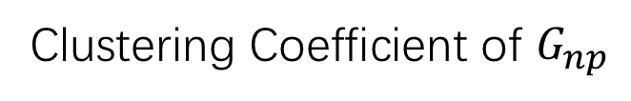
Clustering Coefficient of $G_{np}$

Slide 30
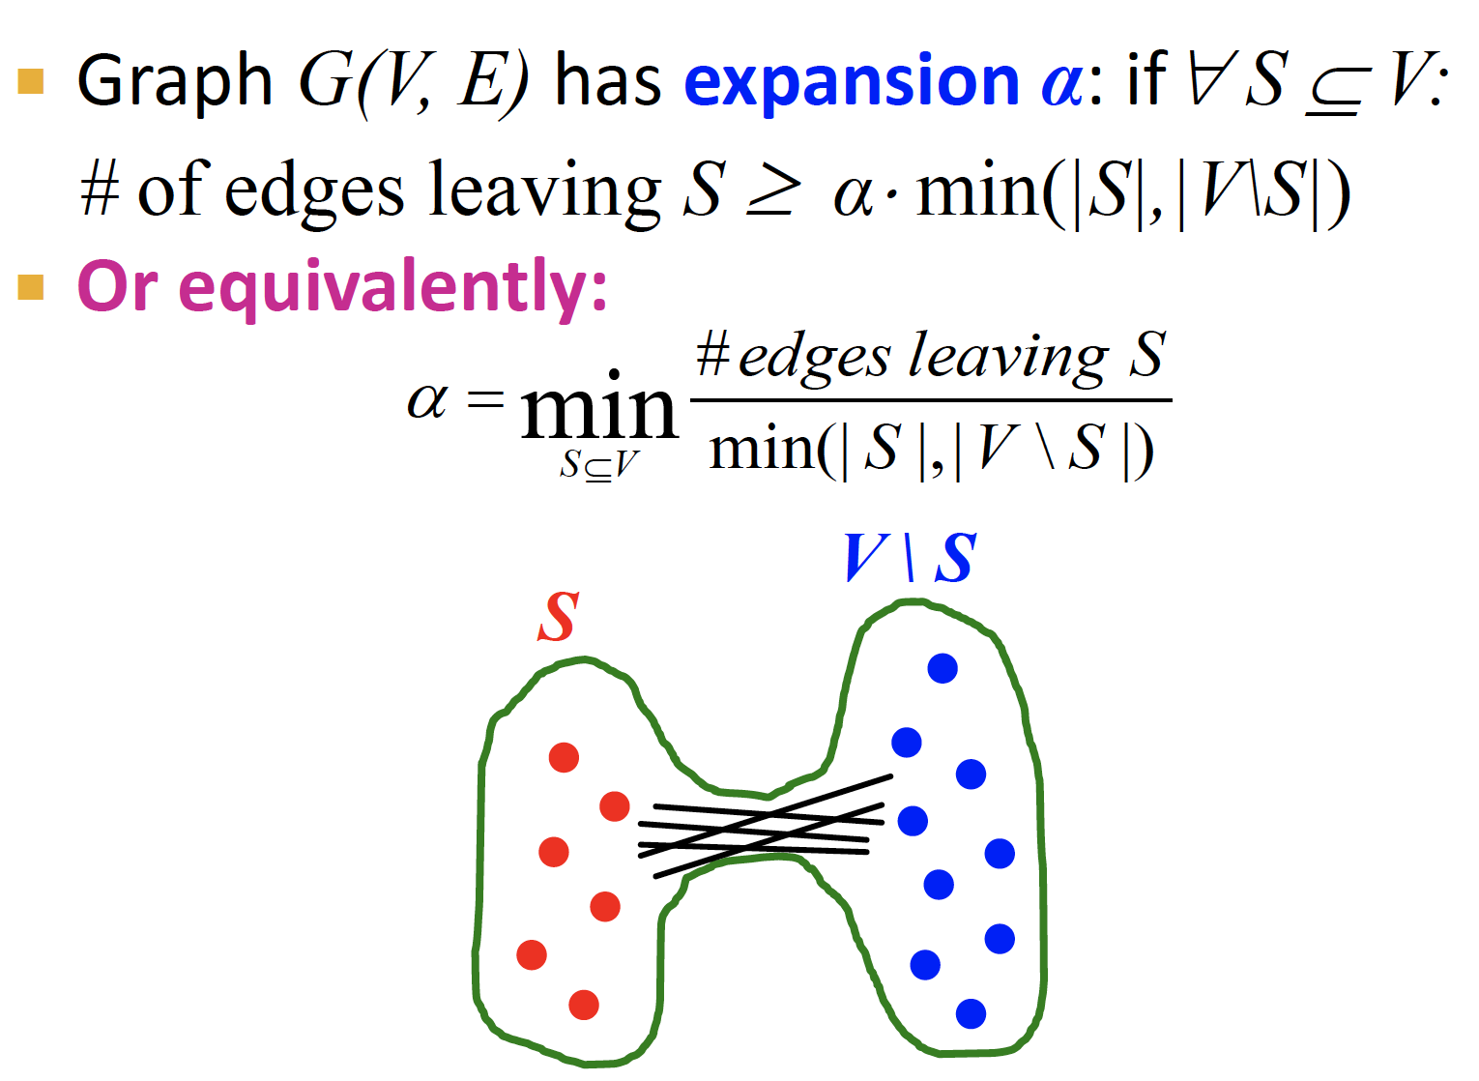
Path Length

Slide 31
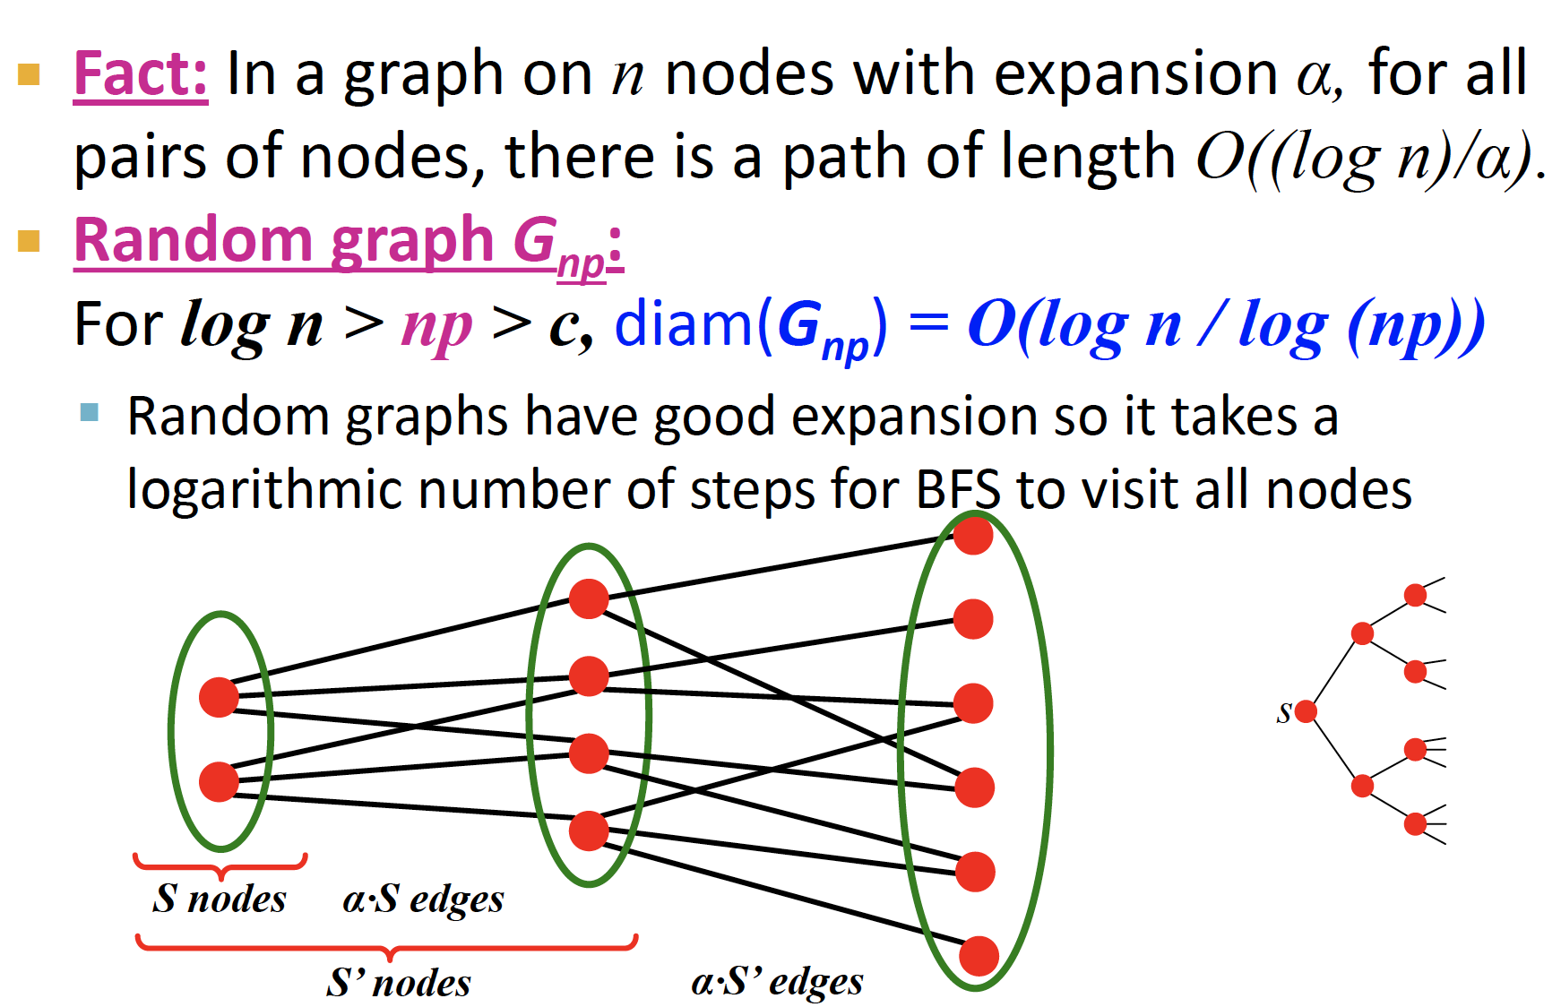
Path Length

Slide 32
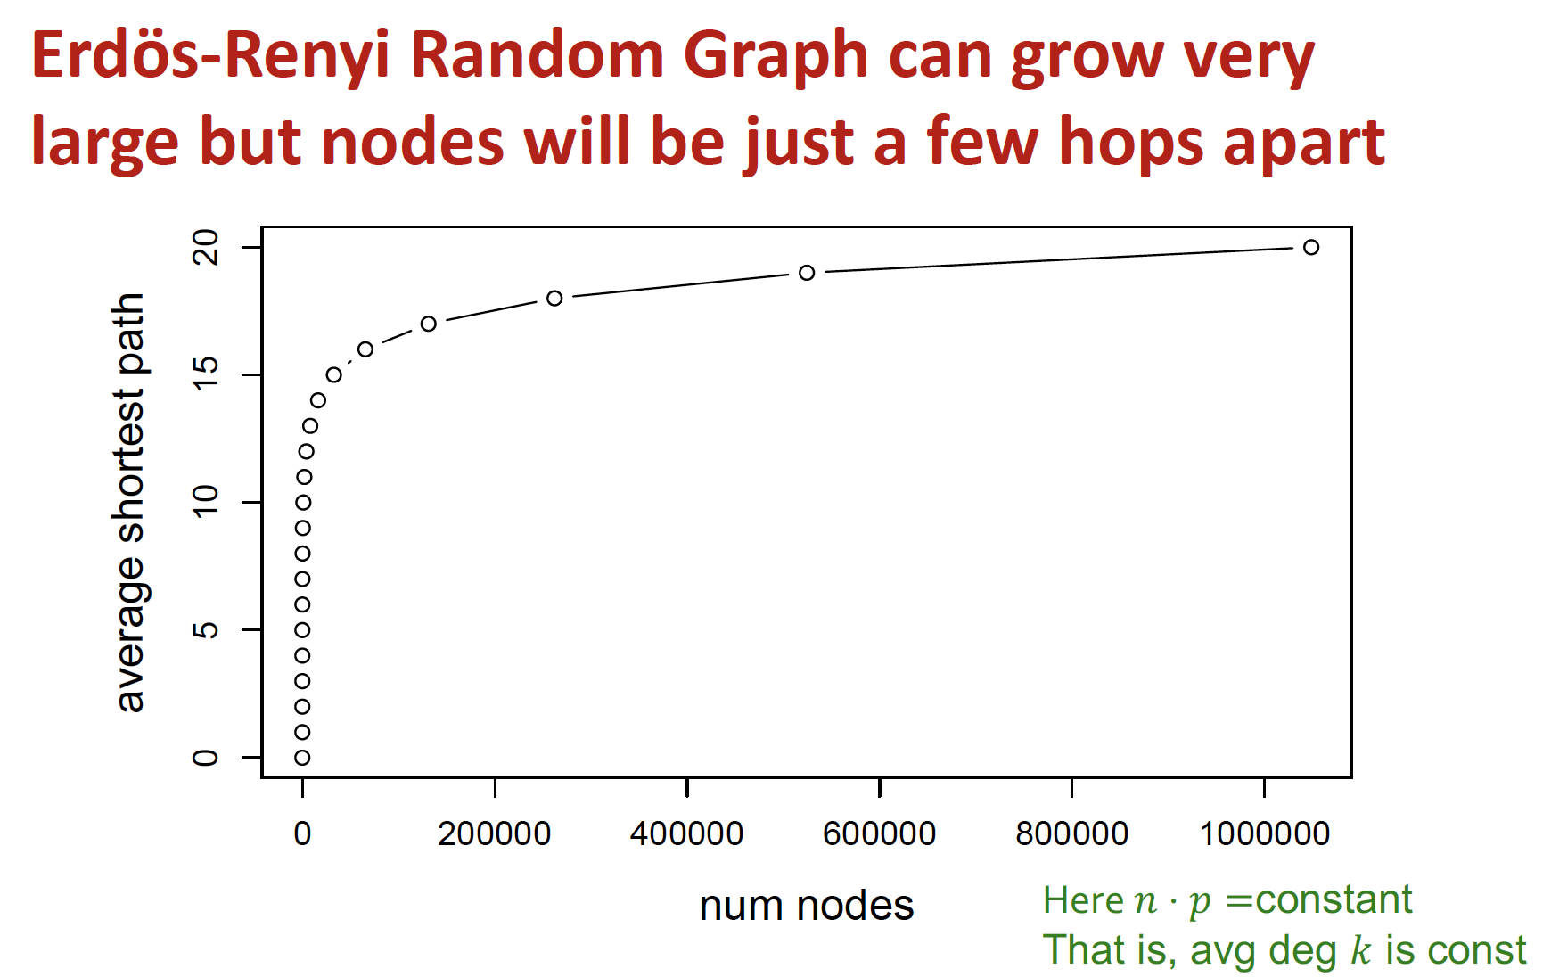
Path Length

Slide 33
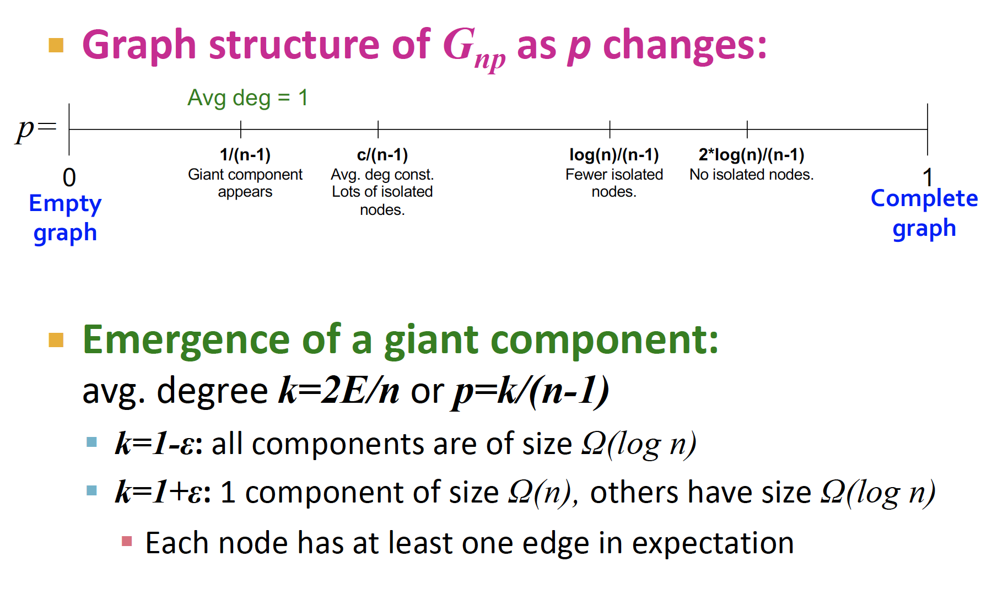
Giant Component

Slide 34
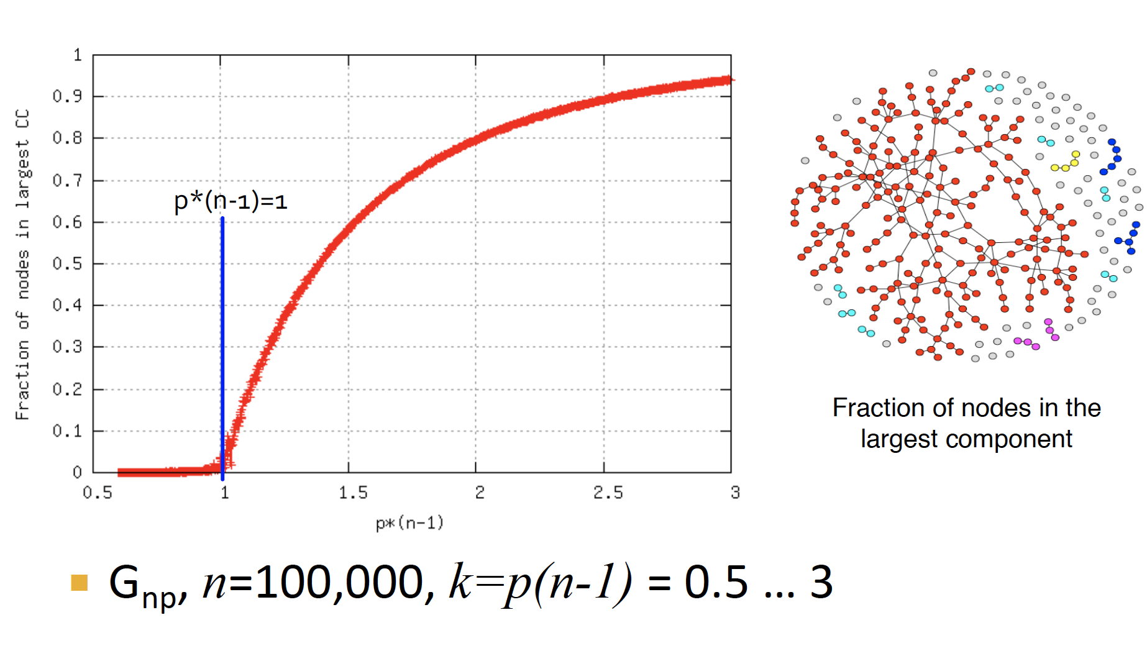
Giant Component
simulation experiments

Slide 35
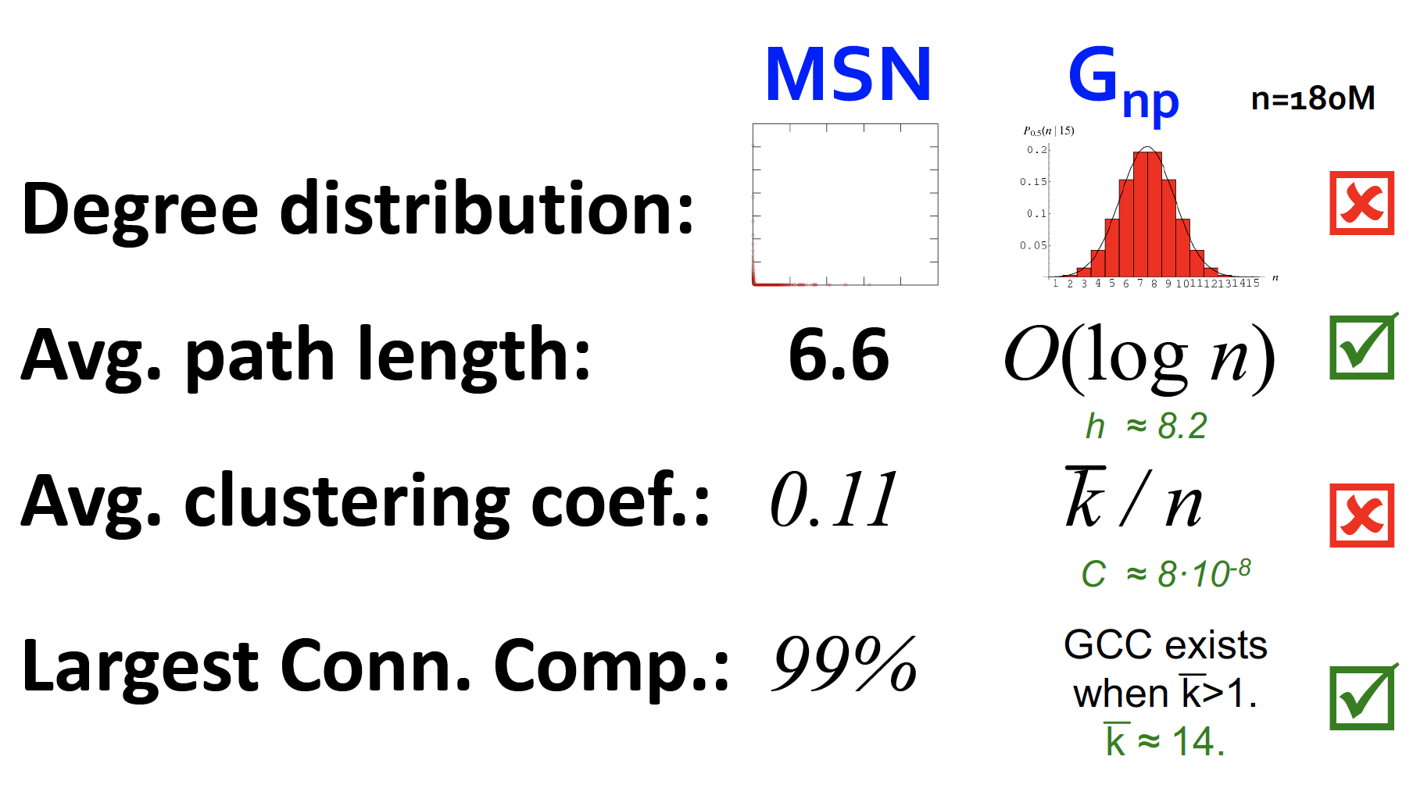
ER model VS.Real networks

Slide 36
ER model VS. Real networks
Are real networks like random graphs ?
Giant connected component:
Average path length:
Clustering Coefficient:
Degree Distribution:
Problems with the random networks model:
Degree distribution differs from that of real networks
Giant component in most real networks does NOT emerge through a phase transition
No local structure – clustering coefficient is too low
Most important: Are real networks random?
The answer is simply: NO

Slide 37
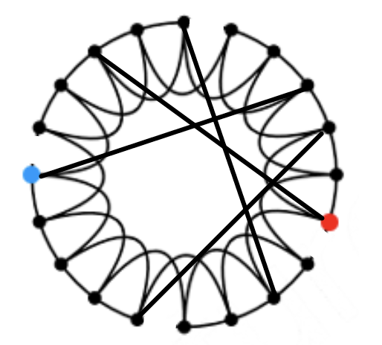
The Small-World Model

Slide 38
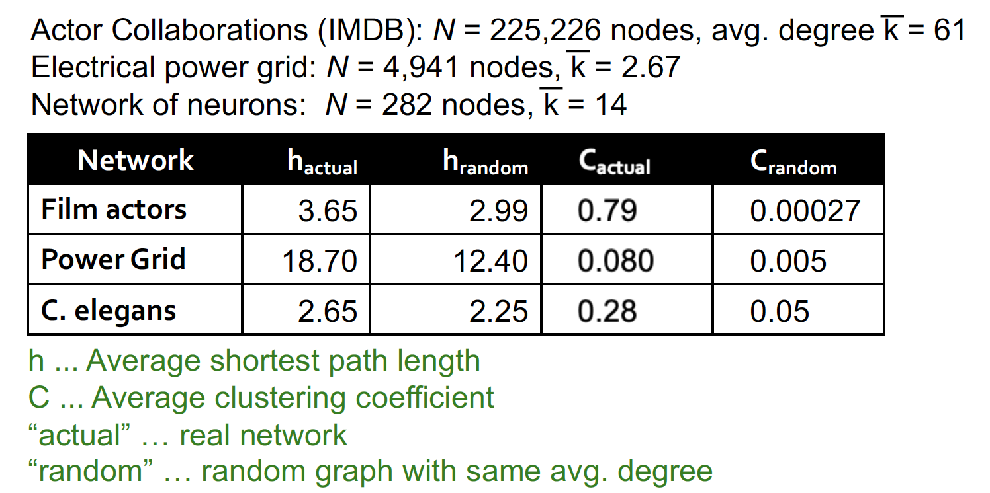
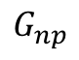
Clustering Implies Edge Locality
MSN network has 7 orders of magnitude larger clustering than the corresponding
Other Examples
$$G_{np}$$

Slide 39
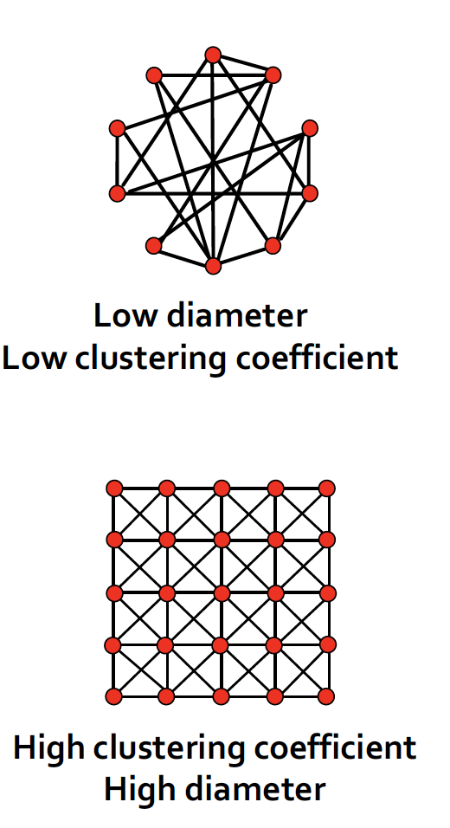
E-R random graph VS. K-regular graph
E-R random graph-consequence of expansion:
Short paths: O(log n). This is the smallest diameter we can get if we keep the degree constant.
But clustering is low!
K-regular networks have “local” structure:
Triadic closure: Friend of a friend is my friend
High clustering but diameter is also high
How can we have both?

Slide 40
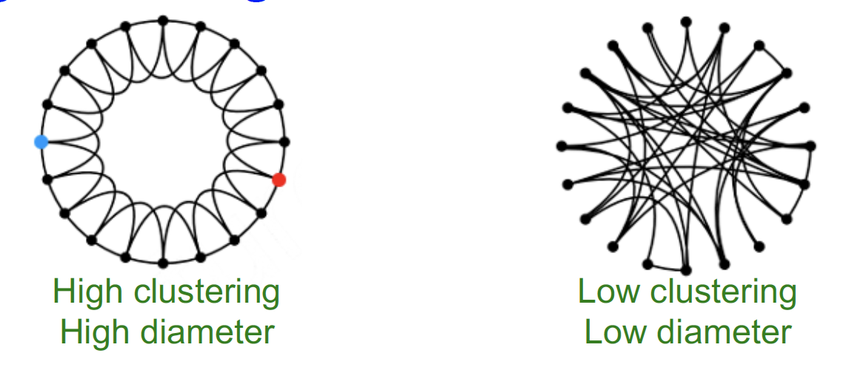
Small-World: How ?
Could a network with high clustering also be small world (have log 𝒏 diameter)?
How can we at the same time have high clustering and small diameter?
Clustering implies edge “locality”
Randomness enables “shortcuts”

Slide 41
Solution: The Small-World Model
Small-World Model [Watts-Strogatz ‘98]
Two components to the model:
Start with a low-dimensional regular lattice
(In our case we are using a ring as a lattice)
Has high clustering coefficient
(2) Rewire: Introduce randomness (“shortcuts”)
Add/remove edges to create
shortcuts to join remote parts
of the lattice
For each edge, with prob. p, move the other endpoint to
a random node

Slide 42
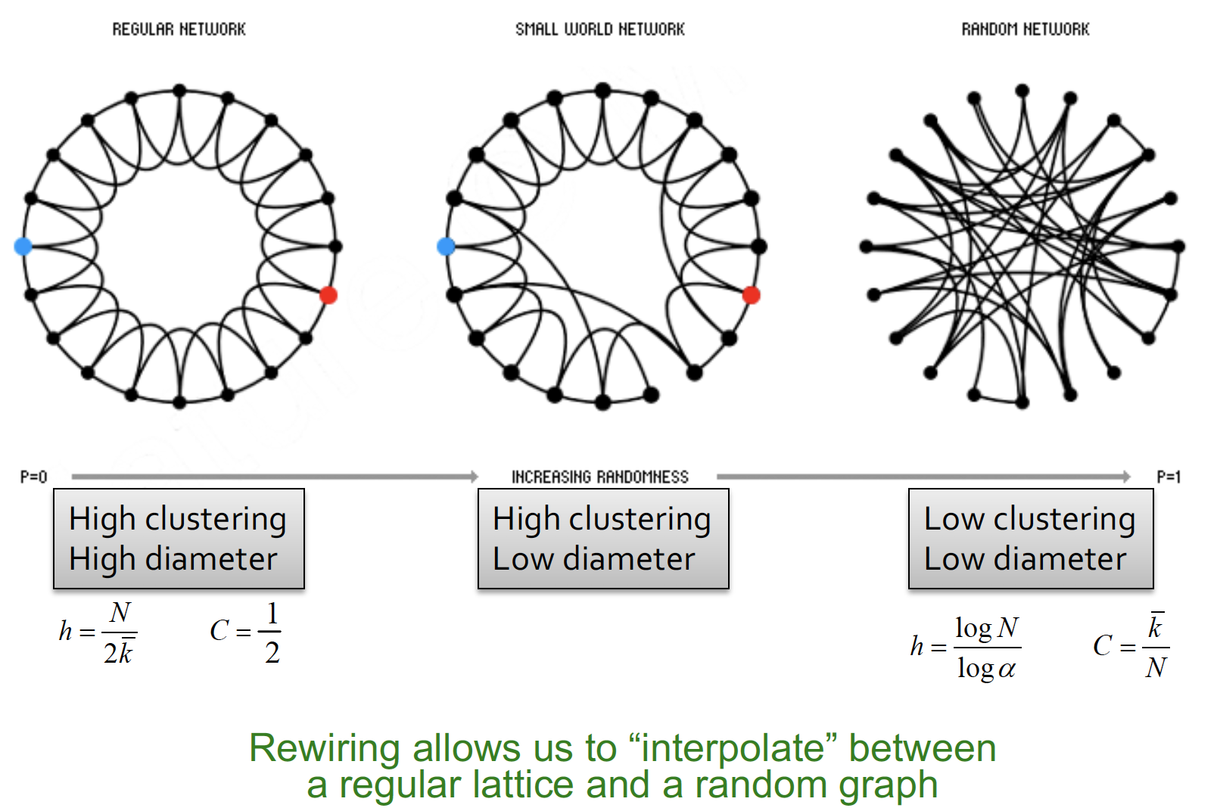
The Small-World Model

Slide 43
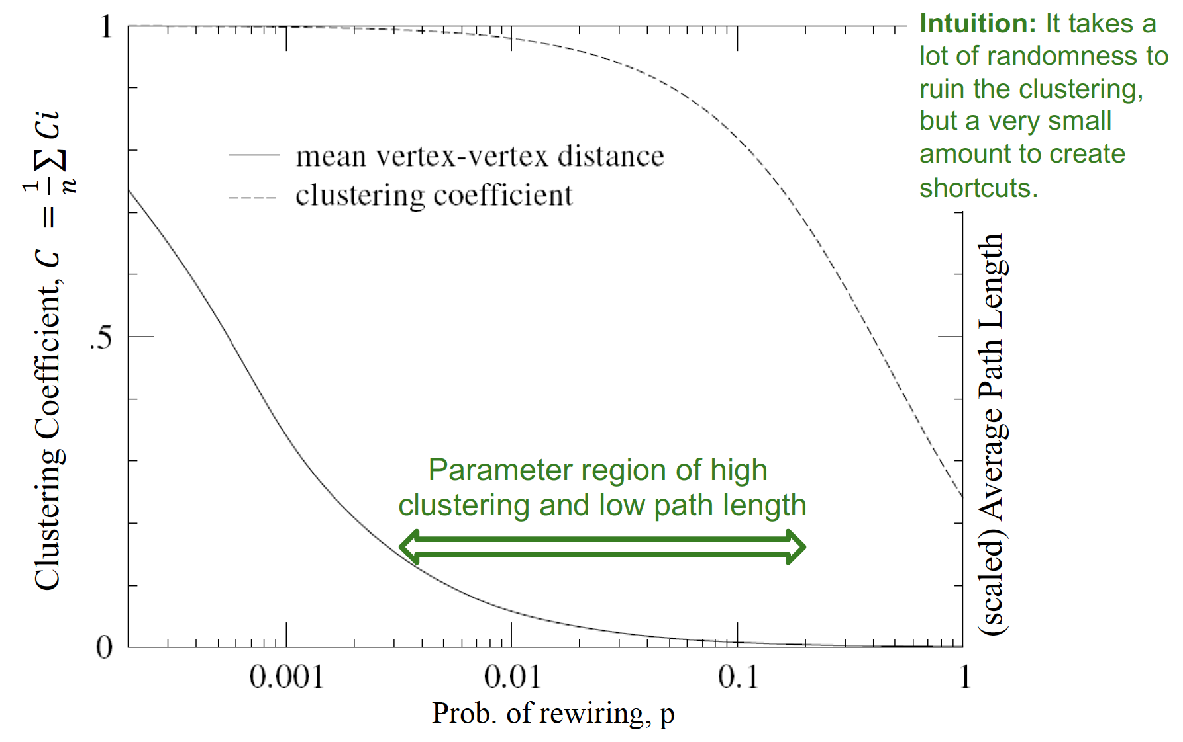
The Small-World Model

Slide 44
The Barabasi-Albert (BA) Model

Slide 45
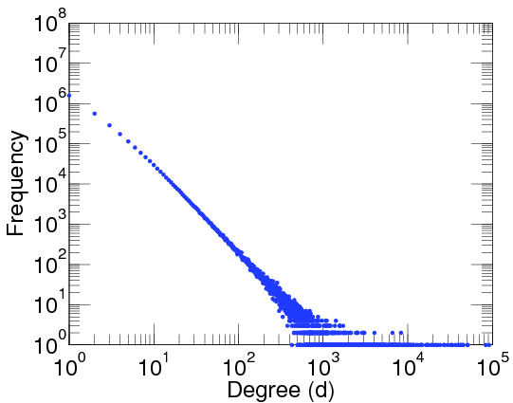
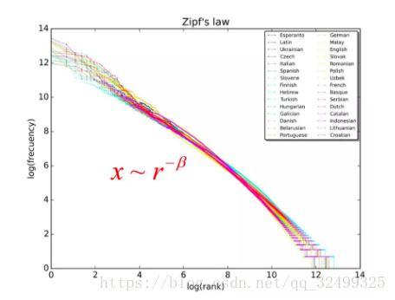
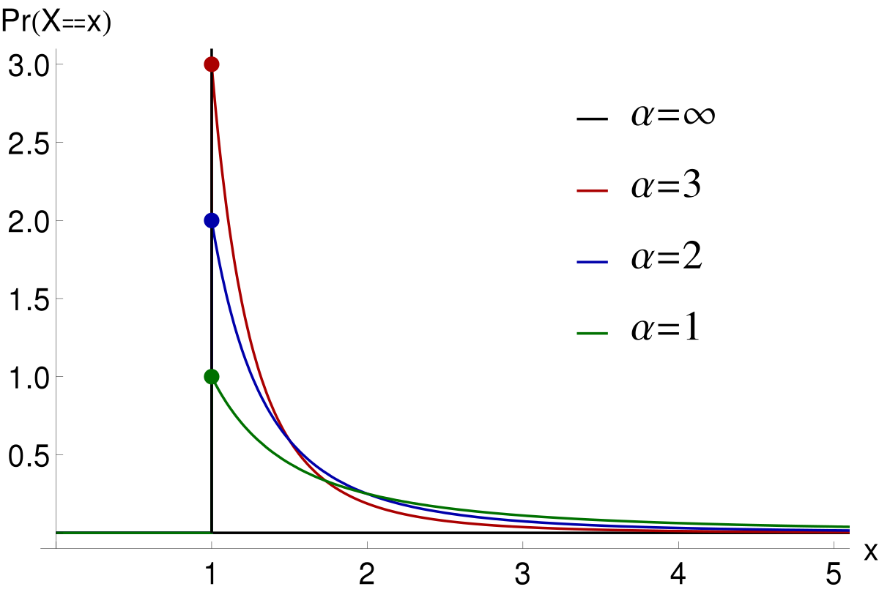
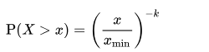
How to model the power-law degree distribution of real-world graphs?
The power-law distribution of node degree
Power law [Price ’65, Barabasi ’99]:
γ: power-law exponent
Zipf’s law
Pareto distribution
The definition of scale-free
f(ck)=g(c)f(k) for any constant c
P(k) ~ k^{-γ}
log(rank)
Power law
Zipf’s law
γ=1+k=1+1/β
Pareto distribution:

Slide 46
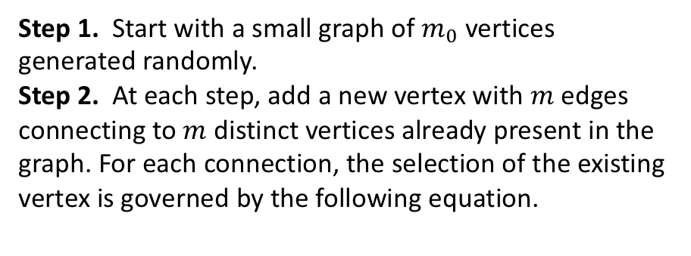
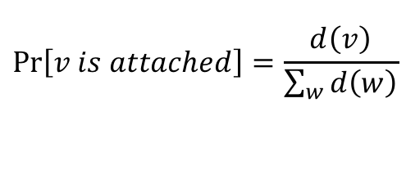
The assumptions of the BA model
Assumptions
Growth: the graph grows continuously
Preferential attachment (i.e., rich-get-richer): nodes with larger connectivity tend to receive new edges
Model definition [Barabasi ’99]
Step 1. Start with a small graph of $m_{0}$ vertices generated randomly.
Step 2. At each step, add a new vertex with $m$ edges connecting to $m$ distinct vertices already present in the graph. For each connection, the selection of the existing vertex is governed by the following equation.
$$\operatorname{Pr}\left[v is attached\right]=\frac{d\left(v\right)}{\sum_{w}{d\left(w\right)}}$$

Slide 47


Degree distribution of the BA model
Property
The degree distribution of a BA graph follows power law distribution of $γ=3.$
Proof [Barabasi ’99]

Slide 48


More rigorous proofs
The master equation method [Dorogovstev ’00]
[Bollobás ’01]

Slide 49






Estimating the power-law exponent of real-world graphs
Curve fitting on the log-log plot is problematic
The dots have different weights
The maximum likelihood estimation [Newman ’05]

Slide 50

Path length of the BA model
The BA model has the diameter with $O\left(\frac{logn}{loglogn}\right).$
[Bollobás ’04]

Slide 51


Generalized Preferential Attachment Models
Non-linear PA [Krapivsky ’00]

Slide 52
Kronecker Graph Model

Slide 53

Recursive Graph Generation
How can we think of network structure recursively?
Intuition: Self-similarity
Object is similar to a part of itself: the whole has the same shape as one or more of the parts
Mimic recursive graph/community growth
Kronecker product is a way of generating self-similar matrices

Slide 54

Kronecker graphs

Slide 55

Kronecker graphs

Slide 56

Kronecker graphs

Slide 57

Kronecker graphs

Slide 58

Stochastic Kronecker Graphs

Slide 59

Stochastic Kronecker Graphs

Slide 60

Stochastic Kronecker Graphs

Slide 61

Stochastic Kronecker Graphs

Slide 62
References
Price, Derek J. De Solla. "Networks of scientific papers." Science (1965): 510-515.
Barabási, Albert-László, and Réka Albert. "Emergence of scaling in random networks." Science 286.5439 (1999): 509-512.
Dorogovtsev, Sergey N., José Fernando F. Mendes, and Alexander N. Samukhin. "Structure of growing networks with preferential linking." Physical review letters 85.21 (2000): 4633.
Bollobás, B´ ela, et al. "The degree sequence of a scale‐free random graph process." Random Structures & Algorithms 18.3 (2001): 279-290.
Newman, Mark EJ. "Power laws, Pareto distributions and Zipf's law." Contemporary physics 46.5 (2005): 323-351.
Bollobás, Béla, and Oliver Riordan. "The diameter of a scale-free random graph." Combinatorica 24.1 (2004): 5-34.
P. L. Krapivsky, . Redner, S., and . Leyvraz, F., “Connectivity of growing random networks,” PRL, vol. 85, no. 21, pp. 4629–32, 2000.

